Slide 1
Static Routing
CCNA Exploration Semester 2
Chapter 2

Slide 2
Topics
Role of the router in networks
Directly connected networks and interfaces
CDP protocol
Static routes with exit interfaces
Summary and default routes
Forwarding with static routes
Managing and troubleshooting static routes

Slide 3
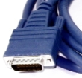
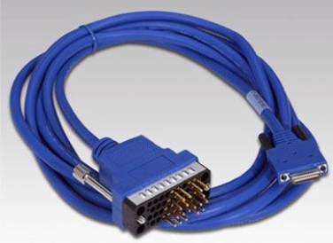
WAN Serial connections
Smart serial connector to router
Larger DB-60 for older routers
V35 DTE connection to ISP CSD/DSU device
Four other standards possible – choose the right cable.

Slide 4
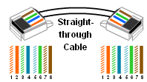
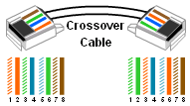
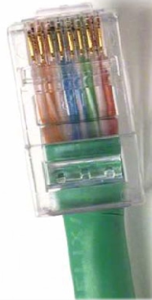
LAN Ethernet connections
Connect to switch or hub.
Connect to another router or a PC

Slide 5

Default condition
By default, interfaces have no IP addresses and are administratively shut down.
They need to be configured.

Slide 6
Configure interface
R1(config)#interface fastethernet 0/0
R1(config-if)#ip address 172.16.3.1 255.255.255.0
R1(config-if)#no shutdown
*Mar 1 01:16:08.212: %LINK-3-UPDOWN: Interface FastEthernet0/0, changed state to up
*Mar 1 01:16:09.214: %LINEPROTO-5-UPDOWN: Line protocol on Interface FastEthernet0/0, changed state to up

Slide 7
Check interfaces
R1#show interfaces fastethernet 0/0
FastEthernet0/0 is up, line protocol is up
Hardware is AmdFE, address is 000c.3010.9260
Internet address is 172.16.3.1/24 etc.
Note MAC address of Ethernet interface
Interface takes part in ARP with its network and keeps an ARP table

Slide 8

Check interfaces
R1#show run
interface FastEthernet0/0
ip address 172.16.3.1 255.255.255.0
(Does not say no shutdown)

Slide 9
Interface not up?
If the interface does not come up – check the cable, check link lights, check the configuration at the other end.
If the protocol does not come up – for Ethernet check that you have the right cable (straight-through or crossover) – for serial check that the clock rate is on the right end of the cable, check that the same Layer 2 protocol is used.

Slide 10
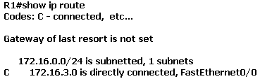
Directly connected
Configure IP address on interface
It appears in routing table
Note subnetting information

Slide 11
Serial interface
R2(config)#interface serial 0/0
R2(config-if)#ip address 172.16.2.2 255.255.255.0
R2(config-if)#no shutdown
This is DTE end
DCE end needs an additional command
R3(config-if)#clock rate 64000

Slide 12
Usual show commands
Check that interface and protocol are up
  show interfaces
  show ip interface brief
  show running-config
Check that network is in routing table
  show ip route

Slide 13
Show controllers
R1#show controllers serial 0/0
Interface Serial0/0
Hardware is PowerQUICC MPC860
DCE V.35, no clock etc.
Shows if a cable is connected
Shows the type of cable
Shows if clock rate set

Slide 14
debug ip routing
R2#debug ip routing
If you give this command before configuring the interfaces then you see a report of the networks being added to the routing table.
R2#no debug ip routing or
R2#no debug all
Switch off debugging as soon as possible after use – it takes up resources.

Slide 15
Cisco Discovery Protocol
Works at layer 2
Directly connected devices only
Cisco devices only
Devices send CDP advertisements to neighbours at regular intervals
Use it to find out about networking devices

Slide 16
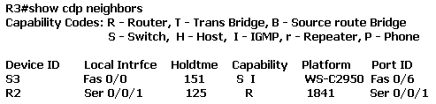
Show cdp neighbors
Does not show IP address
You need show cdp neighbors detail for that.

Slide 17
Going further
CDP only shows immediate neighbours, but it does tell you their IP addresses.
Telnet to the neighbour and then use CDP to find out about its neighbours and so on.

Slide 18
Disable CDP
Disable CDP for the entire device:
Router(config)#no cdp run
Stop CDP advertisements on one interface:
Router(config-if)#no cdp enable
Do this for security.

Slide 19
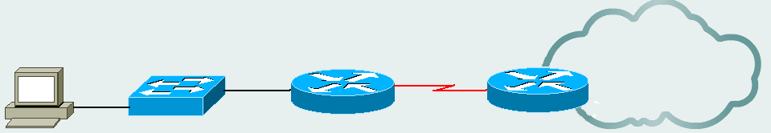
Static routes
Use for stub networks: only one entry.
Stub network
Static route
networks
Default route

Slide 20
Configure a static route
R1(config)#ip route 172.16.1.0 255.255.255.0 172.16.2.2
Give the next hop address
R1(config)#ip route 172.16.1.0 255.255.255.0 Serial 0/0
Or give the exit interface

Slide 21
Show ip route
Routing table now includes:
S 172.16.1.0 /24 [1/0] via 172.16.2.2
Or
S 172.16.1.0 /24 is directly connected, serial 0/0
Administrative distance 1
Metric 0

Slide 22
Return route
If you use static routing, you need to configure static routes in both directions.
A route in one direction does not ensure that there is a route in the other direction.

Slide 23
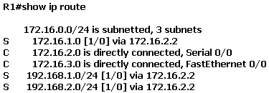
Find a route to 172.16.1.0/24
There it is, via 172.16.2.2
How do you get to 172.16.2.2?
There it is via serial 0/0.
Recursive lookup

Slide 24
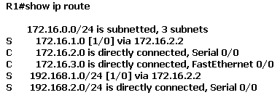
Static route giving interface
R1(config)#ip route 192.168.2.0 255.255.255.0 serial 0/0

Slide 25
Interface down
If the interface used by a static route goes down, then the static route is removed from the routing table.
The static route remains in the configuration.
If the interface comes up again then the static route goes back in the routing table.

Slide 26
Delete a static route
R1(config)#no ip route 192.168.2.0 255.255.255.0 serial 0/0
Give the same command again with no in front.
Most commands can be reversed like this.

Slide 27
Next hop or exit interface?
For a point to point serial link, configure the static route with the exit interface.
  Only one look-up, less processing.
For an Ethernet link, configure the static route with the next hop address (or with both).
  This identifies the device that should receive the packet next. The MAC address can be found and used in the frame header.

Slide 28
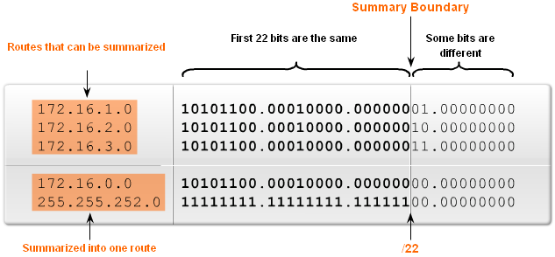
Summarizing static routes

Slide 29
Default route
All packets from the stub network need to go on the same route to the right hand router.
Configure a static default route.
Stub network
Static route
networks
Default route

Slide 30
Configure a default route
Router(config)#ip route 0.0.0.0 0.0.0.0 serial 0/0
Using exit interface.
Router(config)#ip route 0.0.0.0 0.0.0.0 172.16.2.2
Using next hop address
0.0.0.0 network address and subnet mask is called quad zero. It matches anything.

Slide 31
Routing table
S* 0.0.0.0/0 is directly connected, Serial0/0
The default route is shown with a *

Slide 32
Troubleshooting tools
ping
traceroute
show ip route
show ip interface brief
show cdp neighbors
show running-config

Slide 33
The End

